Slide 1
More on Control Chart Pattern Tests BUSI 104
Recognizing Out-of-Control Signals and Identifying Possible Root Causes

Slide 2
Out of Control Signal A: 1 point more than 3 SD from CL
Often indicates immediate, severe change to process inputs

Slide 3
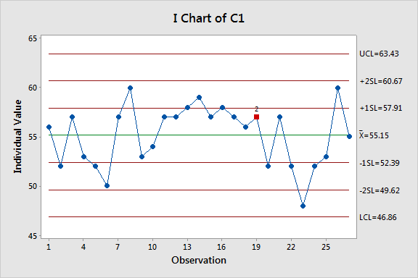
Out of Control Signal B: 9 Consecutive points on Same Side of Centerline
Often referred to as a shift to process.
Often caused by constant changes to inputs of process.
Can indicate process improvements HAVE successfully shifted process.

Slide 4
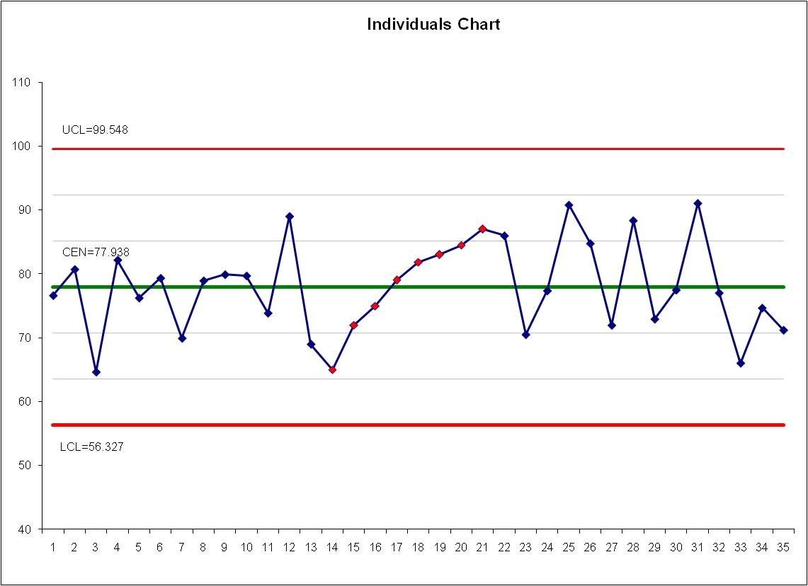
Out of Control Signal C: 6 points in a Row Steadily Increasing or Decreasing
Indicates trend in process. Noting this symptom early, you can often fix problem BEFORE process goes out of specification.

Slide 5
Out of Control Signal D: 14 consecutive points alternating up and down
Often referred to as “Two Somethings” symptom. Might be data from two shifts, day and night or other rhythmic process change.

Slide 6
Out of Control Signal E: 2 out of 3 Points in SAME Zone A or beyond
Often an immediate, somewhat severe change to inputs of process. Cannot always been seen with naked eye, so best to use software.

Slide 7
Out of Control Signal F: 4 out of 5 points in SAME Zone B or Beyond
Often somewhat immediate, somewhat severe change to inputs of the process. Not always seen well with naked eye, so best to use software. Often, if not addressed, Zone B symptoms will turn into Zone A symptoms, then into outliers as process continues to degrade.

Slide 8
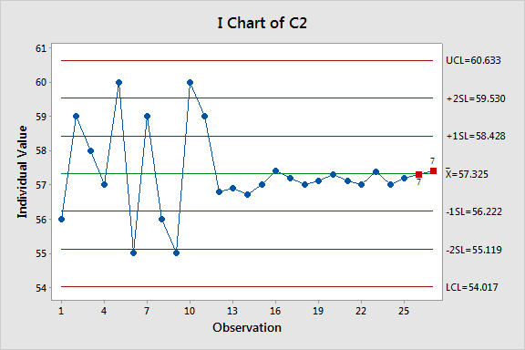
Out of Control Signal G: 15 Consecutive Points in Either Zone C
Often Two Possible Causes:
Process improved. If so, control chart limits should be split with new control chart starting at first point of “new” process.
Manipulated data. People have difficult time creating random data, and when attempting, sometimes this symptom occurs.

